Slide 1
MCTE 3104 Mechatronics Interfacing Lab
Session no. 5 : Software – Hardware UART communication

Slide 2
Outline
Software – Hardware Interfacing
Python script to read and transmit
Device (RFID reader)
Read RFID UID

Slide 3
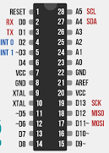

Recap
Typical device to PC interfacing
TX
RX
GND
USB-UART
converter
When a device is connected a ‘COM’ port is established at the PC

Slide 4
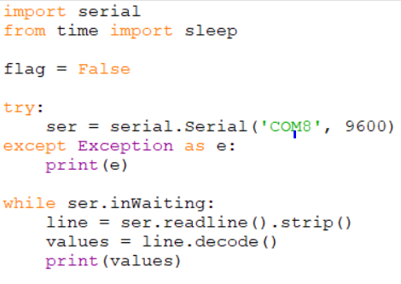
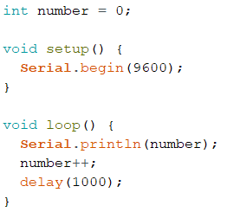
Serial communication Python to Arduino
Serial communication Python to Arduino
Example 1: Reading values from Arduino
Example 1: Reading values from Arduino
Python script
Arduino script

Slide 5
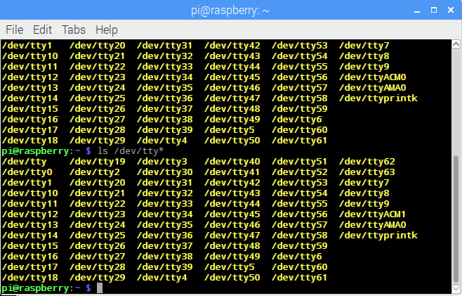
Serial communication Python to Arduino
For linux based machine, ‘COMx’ should be replace with ‘ttyx’
type in terminal:
ls /dev/tty*
Find your device by unplugging your Arduino and then plugging it back in to the raspberry pi.

Slide 6
Serial communication Python to Arduino
Lab activity 1:
Using Arduino transmit potentiometer reading to python script running on a raspi.

Slide 7
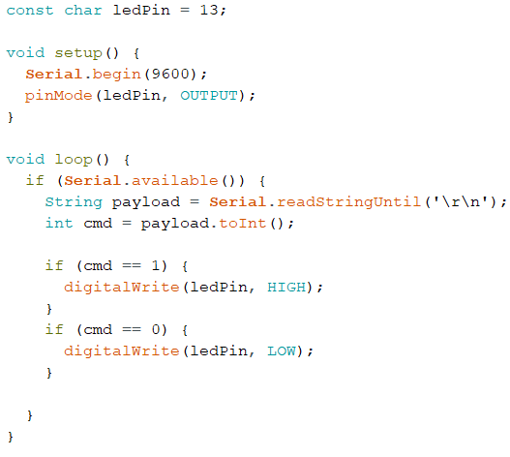
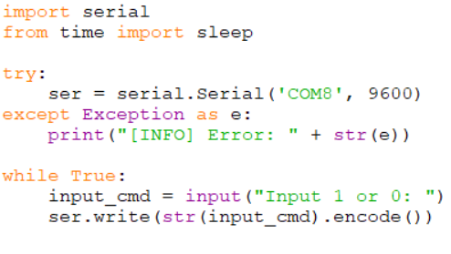
Serial communication Python to Arduino
Example 2: Python transmitting values to Arduino
Python script
Arduino script

Slide 8
Serial communication Python to Arduino
Lab activity 2:
Write python script that will take angle input in degrees and transmit it to the Arduino which will then actuate a servo and move to that angle.

Slide 9
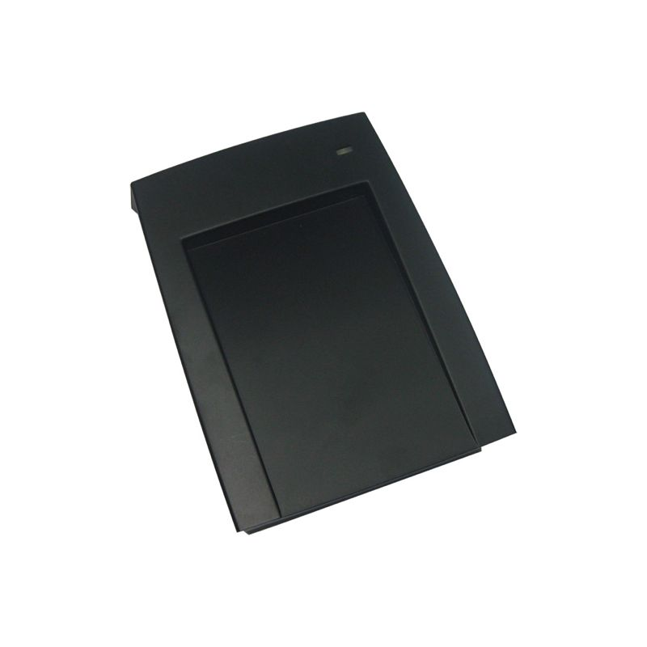
Interfacing our RFID reader device to PC
TX
RX
GND
USB-RS232
converter
When a device is connected a ‘COM’ port is established at the PC

Slide 10
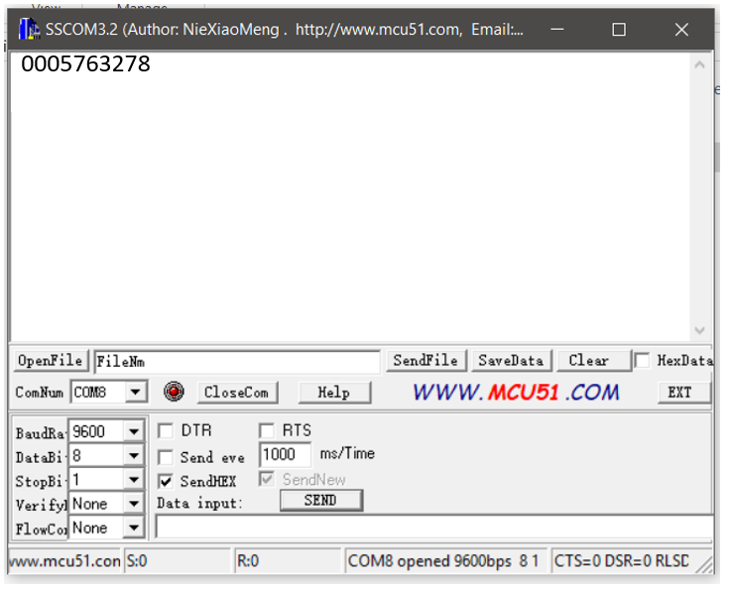
Example 3: Reading RFID UID
Use SSCOM32 to read your RFID CARD UID

Slide 11
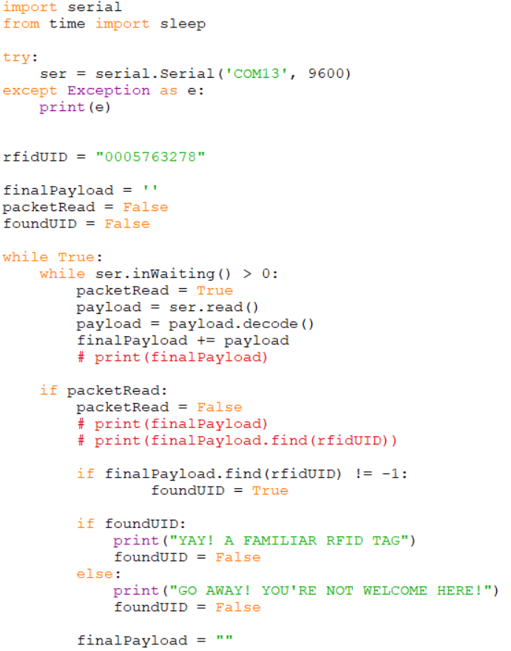
Example 3: Reading RFID UID
Sample code that reads and verify the card read equals the hard coded UID

Slide 12
Text-based data storing
Often times when you’re developing a system you’re required to save and store data. You need to store these data for further usage. Remember in the previous example we hard coded the UID to verify on the Python code itself. Imagine you have hundreds of UIDs you want to include and blacklist in your application. Hard coding the UIDs will not be a practical. One practical way is to have a separate file that stores all your UID data and have a code that reads the stored UID (data) and use them in your application.

Slide 13
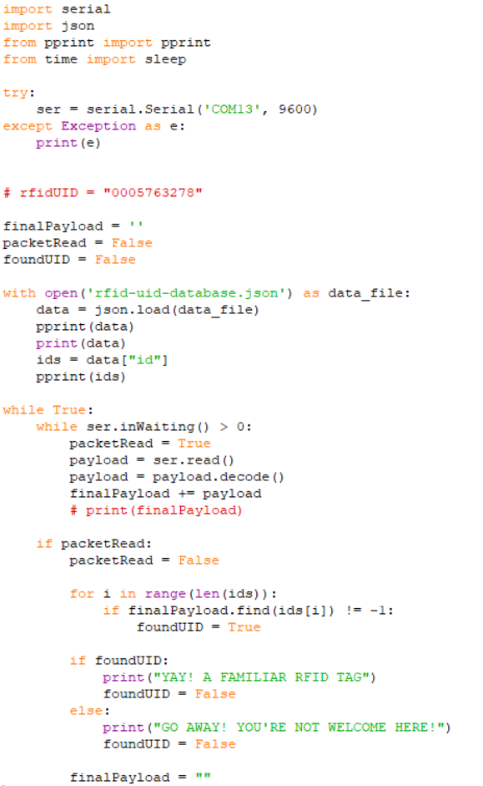
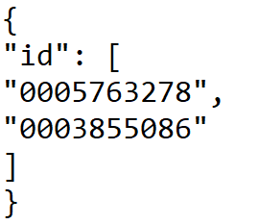
Example 4: Reading RFID and cross checking UID from Json file
Create a .json file called rfid-uid-database.json and then save this inside it

Slide 14
Serial communication Python to Arduino
Lab activity 3:
Use the previous code to light up a green led if stored UID is read by the RFID reader and light up a red led if unknown card is read by the RFID reader.

